Slide 1


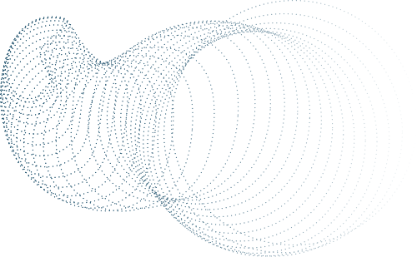



IMAGE COLORIZATION
PROJECT

Slide 2


Table of Content
Introduction
Preprocessing
Model
Training
Application
Streamlit
Final Result

Slide 3
Introduction
Preprocessing
Model
Training
Application
ABOUT THE PROJECT
This project focuses on image colorization using deep learning techniques. The goal is to convert grayscale images into colorized outputs by predicting chromatic (AB) channels in the LAB color space, while using the lightness (L) channel as input.
We utilize a pretrained VGG16 encoder to extract features and a custom decoder to reconstruct colorized images. The training pipeline leverages about 7 GB dataset of images derived from ImageNet, with MSE loss for channel prediction and the Adam optimizer for weight updates. The final model is capable of transforming grayscale images into visually plausible colorized images, with potential applications in photography, film restoration, and historical image enhancement.

Slide 4
Introduction
Preprocessing
Model
Training
Application
Preprocessing Step
In the preprocessing step, all images are resized to a fixed dimension of 128×128 and converted to the LAB color space. The L channel (lightness) is extracted and used as the model input, while the A and B channels (chromatic components) are normalized to the range [−1,1] and used as the target output. This ensures the model learns to predict the missing color information while preserving the structural details from the grayscale input. The processed images are then batched and loaded using PyTorch DataLoader for efficient training.

Slide 5
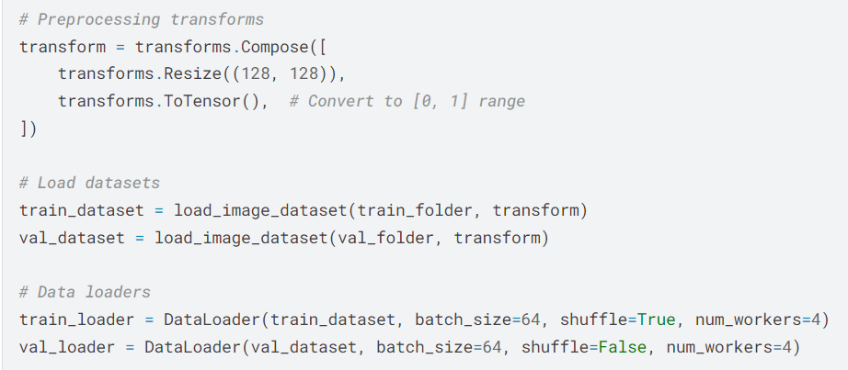
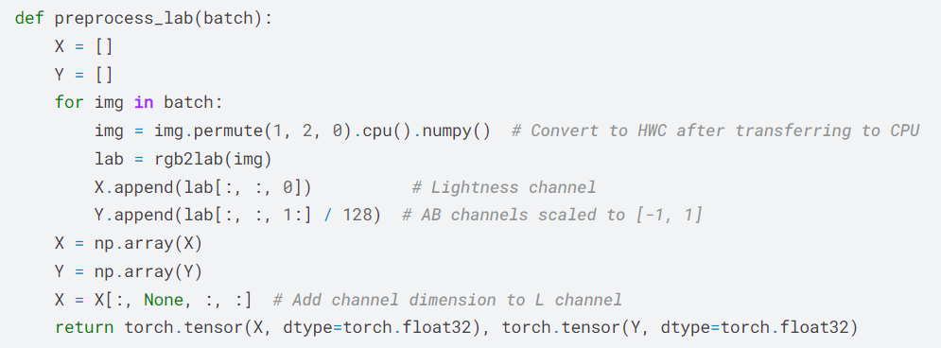
Introduction
Preprocessing
Model
Training
Application
Preprocessing

Slide 6
Introduction
Preprocessing
Model
Training
Application
Model Structure
The model consists of two primary components: an Encoder and a Decoder, forming a deep neural network for image colorization.
1-Encoder:
The encoder is based on a pretrained VGG16 model, truncated to use the first 23 layers. This extracts high-level features from the input lightness (L) channel, providing the model with spatial and semantic information about the image. The pretrained weights are frozen to retain their general feature extraction capabilities.
2-Decoder:
The decoder is a custom upsampling network designed to reconstruct the chromatic (AB) channels. It uses a series of convolutional layers, ReLU activations, and bilinear upsampling to gradually expand the spatial resolution of the features back to the original image size. The final layer outputs the predicted AB channels, scaled to [−1,1] using a Tanh activation function.
Together, the encoder extracts meaningful features from the grayscale input, and the decoder learns to reconstruct the missing color information to generate a fully colorized image.

Slide 7
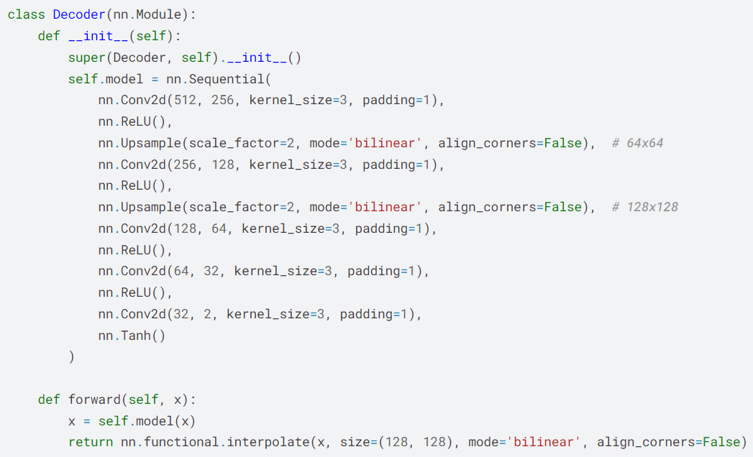
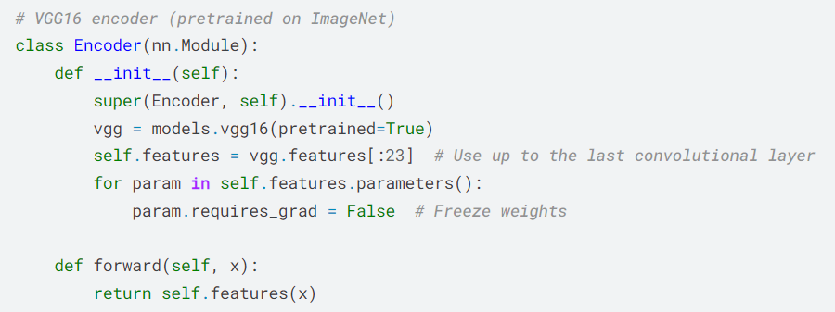
Introduction
Preprocessing
Model
Training
Application
Model

Slide 8
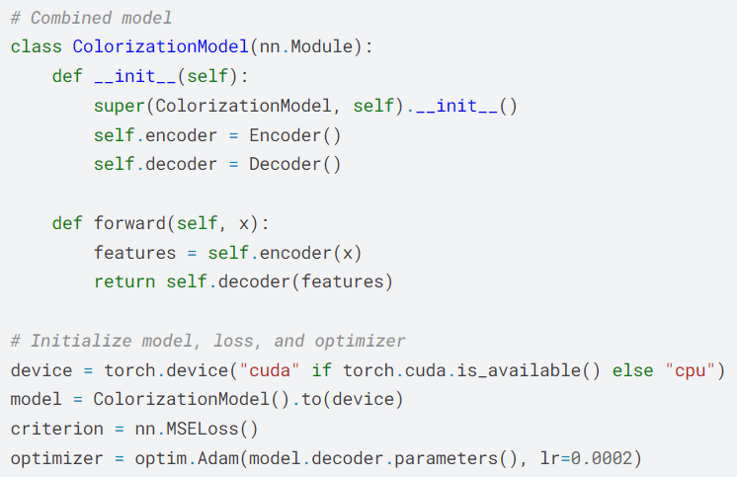
Introduction
Preprocessing
Model
Training
Application
Model

Slide 9
Introduction
Preprocessing
Model
Training
Application
Training
The training loop teaches the model to predict color (AB channels) from grayscale (L channel). For each batch:
Images are preprocessed into LAB format (L as input, AB as target).
The L channel is repeated to match the encoder's input.
The model predicts AB, and the MSE loss is calculated with the ground truth.
Gradients are computed, and the optimizer updates the decoder weights.
The average loss for the epoch is printed.
This process repeats for all epochs to optimize the model's predictions.

Slide 10
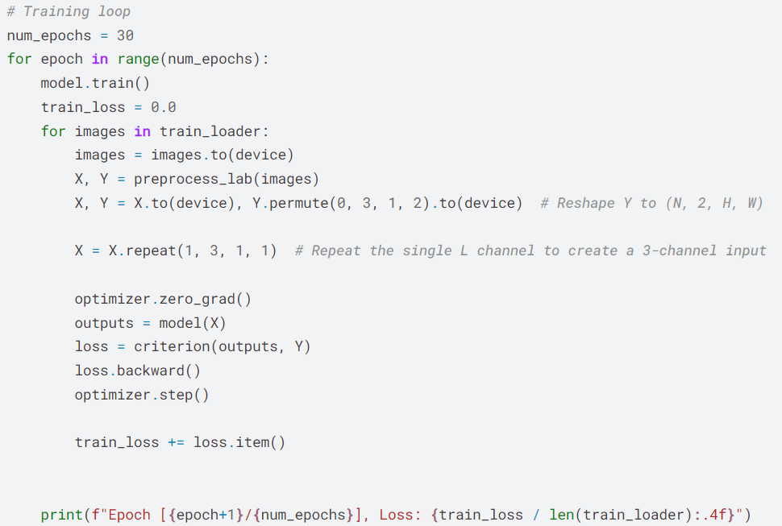
Introduction
Preprocessing
Model
Training
Application
Training

Slide 11
Introduction
Preprocessing
Model
Training
Application
Application
The Application part evaluates the trained model and visualizes the results:
Model Loading: The trained model weights are loaded, and the model is set to evaluation mode.
Preprocessing: A sample image is converted to the LAB color space, and only the L channel (grayscale) is used as input.
Prediction: The model predicts the AB channels from the L channel.
Reconstruction: The predicted AB channels are combined with the original L channel to form a LAB image, which is converted back to RGB.
Visualization: The original image and the colorized result are displayed side by side for comparison.

Slide 12
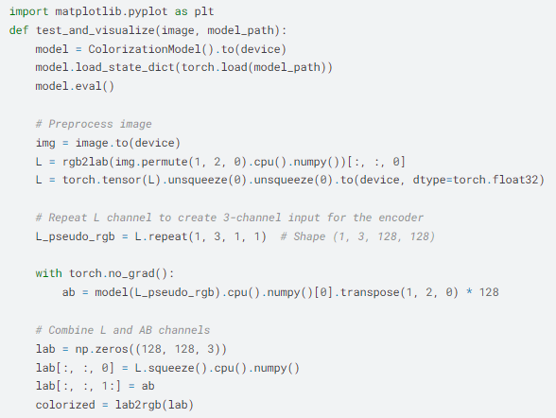
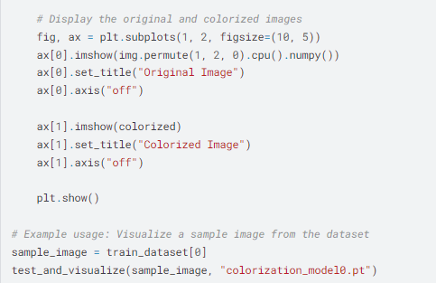
Introduction
Preprocessing
Model
Training
Application
Application

Slide 13
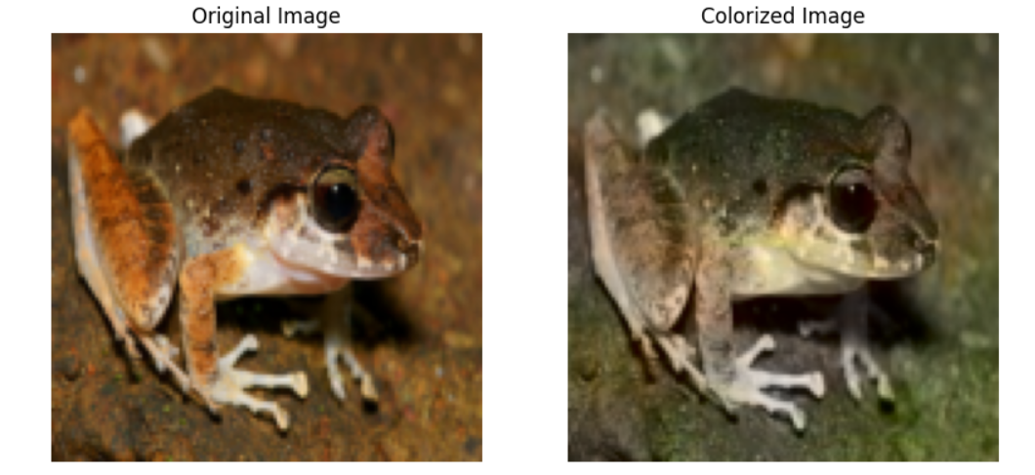
Introduction
Preprocessing
Model
Training
Application
The Output:

Slide 14
Streamlit
We are integrating Streamlit into this project to create an interactive web-based application for image colorization and post-processing. Streamlit provides an intuitive interface where users can upload images, adjust colorization and post-processing settings, view the enhanced outputs generated by the model, and compare them with the originals. This addition enhances the project's usability, making it accessible for users to experiment with and visualize the colorization process interactively and in real time.

Slide 15
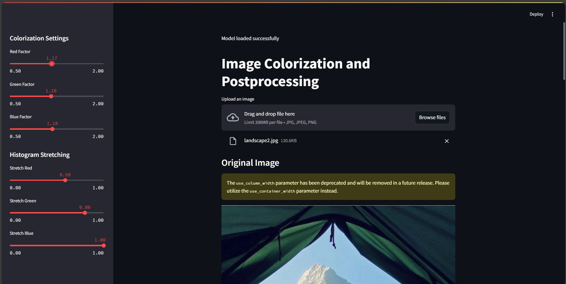
Final Result
The interface:

Slide 16
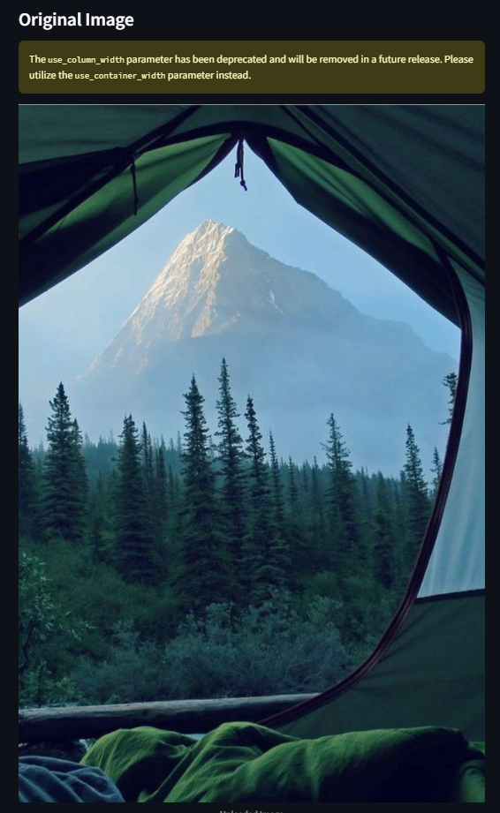
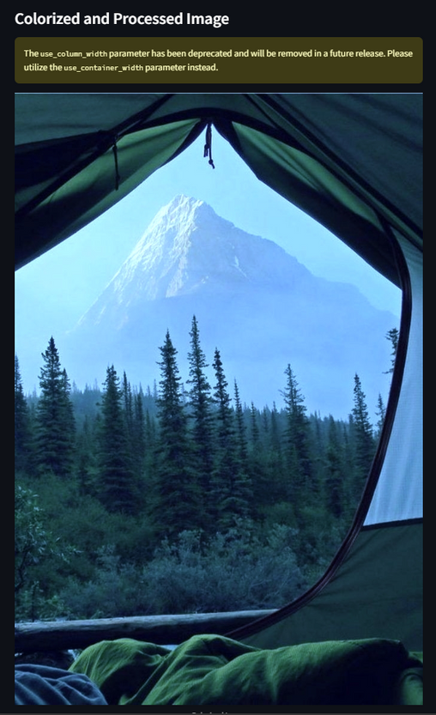
Final Result
Example of usage:

Slide 17
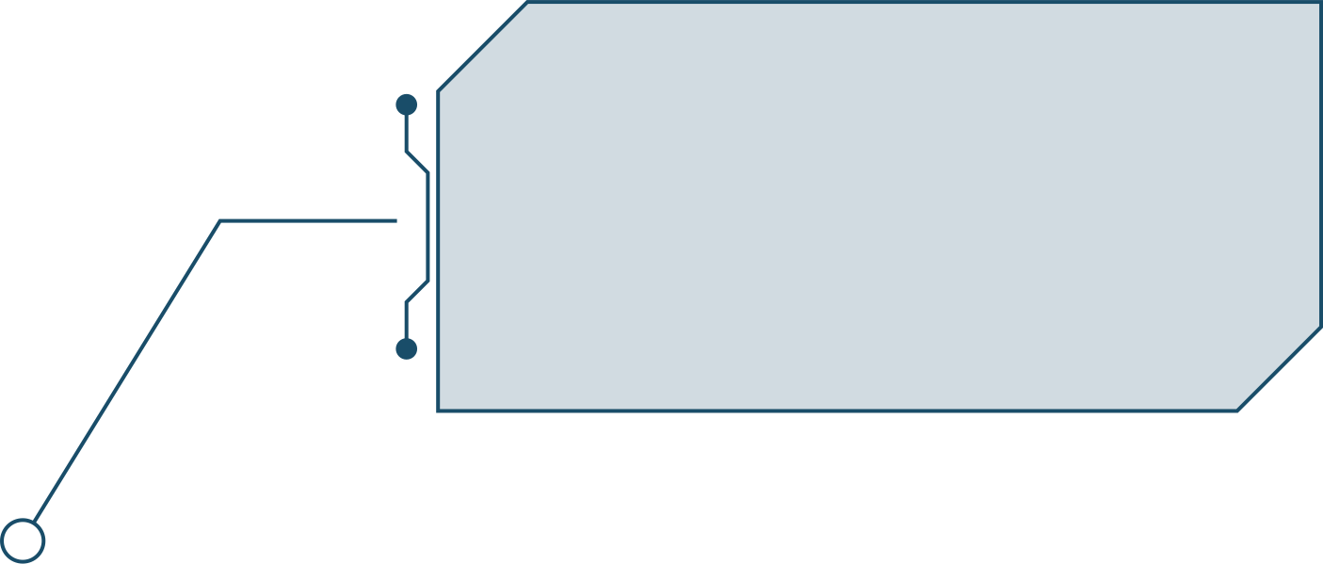
TEAM MEMBERS
Magdolen Hany
Mohamed Azb
Mohannad Magdy
Nawal Mohamed
Rawan Ahmed
Sama Tarek
Shaimaa Mohamed
Yousef Fawzi

Slide 18
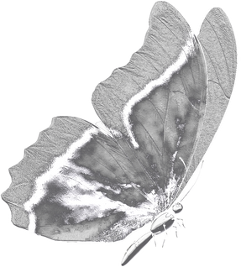
THANK
YOU

